Slide 1
How Do We Estimate f?
Training data
Use the training data and a learning method to estimate f.
Learning Methods:
Parametric Methods (pre-determined structure)
Non-parametric Methods (flexible)
Notes:
(CLICK) Training data is the part of the data used for building the machine-learning model. (CLICK) Assume we have n observations in the training data. X is represented in bold to indicate that X is a vector, meaning, there are many X variables. (CLICK) We use this training data and a learning method to estimate the unknown (True) function f. (CLICK) Learning methods can be of two kinds: it would be either (CLICK) parametric or (CLICK) non-parametric.
As you progress in this field, you would recognize that there are many tuning parameters even in non-parametric methods. Parametric simply means there is a pre-determined model structure and non-parametric means algorithm allows any shape.

Slide 2
Parametric Methods
Shape is predetermined.
To Estimate f, we estimate a set of parameters.
They involve a two-step model based approach
STEP 1:
Make some assumption about the functional form of f, i.e. come up with a model.
Linear model i.e.
Notes:
(CLICK) Like we just mentioned, in parametric methods, the shape of the f function is assumed to be known. (CLICK) Estimating f function boils down to simply estimating parameters for that function. (CLICK) Fitting models using Parametric methods involves two steps. (CLICK) In step 1, we assume the function form for the unknown function f. (CLICK) The most common example for parametric method is linear regression (CLICK) given by this equation. Since we assume this is the function form, our job reduces to estimating the Betas.

Slide 3
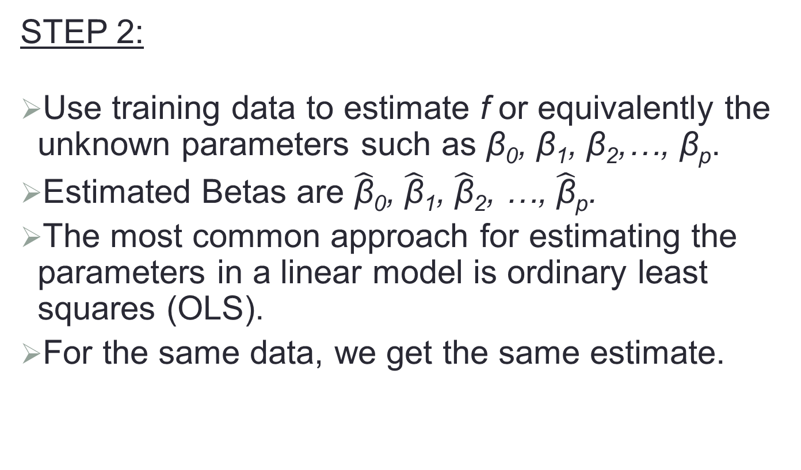
Parametric Methods (cont.)
STEP 2:
Use training data to estimate f or equivalently the unknown parameters such as β₀, β₁, β₂,…, β_{p}.
Estimated Betas are $\hat{\text{β}}$₀, $\hat{\text{β}}$₁, $\hat{\text{β}}$₂, …, $\hat{\text{β}}$_{p}.
The most common approach for estimating the parameters in a linear model is ordinary least squares (OLS).
For the same data, we get the same estimate.
Notes:
(CLICK) In the step # two, we estimate the unknown Betas that we just saw in the equation. We use the training data to learn about these Betas. Once we estimate the unknown Betas, we have estimated the unknown function f. (CLICK) We use Betas with hats to represent the estimated Betas. (CLICK) We use a method called ordinary least squares to estimate the Betas. (CLICK) When we use the ordinary least squares method, we should get the same estimates for a given data. Therefore, no matter who fits the model, the parametric method will result in the same model for a given data. We will review ordinary least squares in a different topic.

Slide 4
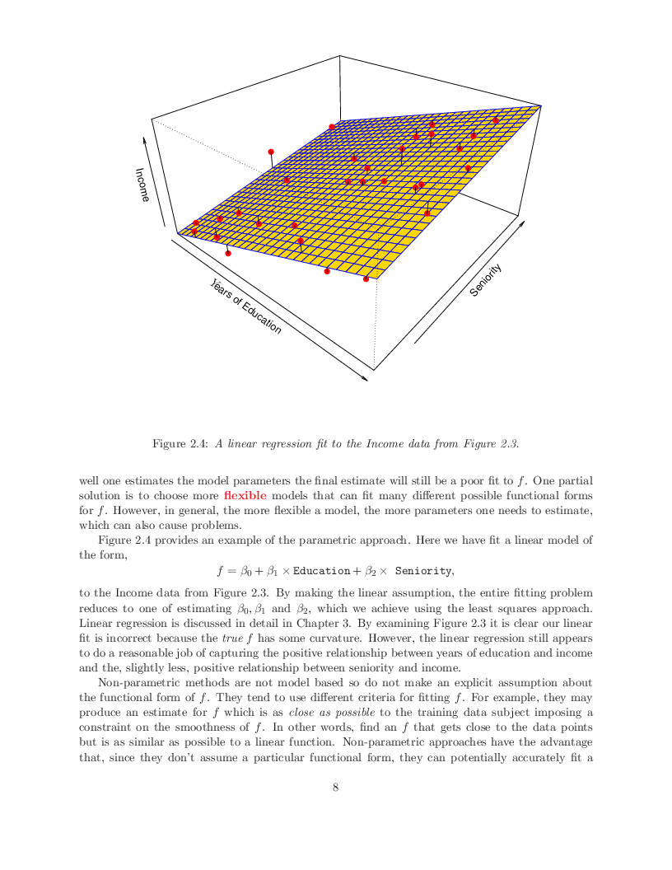
Parametric Model Example: A Linear Regression Estimate
Notes:
In this example, (CLICK) income is the Y variable. (CLICK)(CLICK) Education and Seniority are X variables. (CLICK)(CLICK) The red dots are the training data. (CLICK)(CLICK) The unknown function is assumed to be linear. (CLICK)(CLICK) Our job boils down to estimating these unknown Betas using the training data. By applying ordinary least squares method to the data, we estimate the Betas and get the linear regression model (CLICK) (CLICK) represented by this plane. Ideally, we want the difference (CLICK) (CLICK) between red dots and the linear regression model to be zero or very small. Because of the irreducible error, we may not be able to accurately predict income even when the true function is linear.

Slide 5
Non-parametric Methods
No assumptions about function form of f.
There are tuning parameters.
Advantages: They accurately fit a wider range of possible shapes of f.
Disadvantages: A very large number of observations is required to obtain an accurate estimate of f. They can also over fit the data.
Notes:
Machine-learning models are non-parametric in nature. (CLICK) By non-parametric, we really mean that these models do not assume a function form or a structure a priori. I want to point out that the term non-parametric could be misleading because non-parametric models DO (CLICK) have tuning parameters which are chosen while building models. (CLICK) Generally speaking, non-parametric methods are flexible and accurate. (CLICK) The main disadvantage is that they need a lot more data to accurately estimate f function. There is also the danger of overfitting. If we are not careful, non-parametric models will try to fit the given data too much which will result in a poor prediction when the model is applied to a different data set.

Slide 6
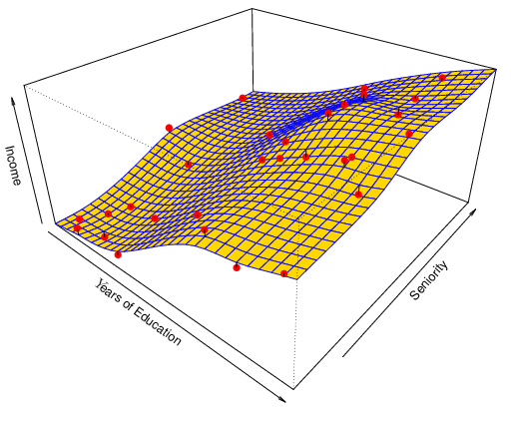
Non-Parametric Example: A Spline Estimate
Non-linear regression methods are more flexible and can potentially provide more accurate estimates.
Notes:
As an example to the non-parametric method, we have applied a spline model to the same data set that we saw earlier. We can see that the non-parametric method has resulted in a flexible (non-linear) model structure. (CLICK) It has the potential to accurately estimate the unknown function f. But we should be careful about the non-parametric methods; If we are not careful, these flexible models can go through every red dot and over fit the given data. It will be a great fit for the given data but the model will perform poorly when used in a different data set.

